Slide 1
Customer Experience
- Claims

Slide 2





Cashless Claim Process
Customer approaches Bajaj Allianz
Network Hospital for cashless treatment
Hospital verifies customer details and sends the
Preauthorization form duly completed ,
by portal to Bajaj Allianz – HAT (Pune)
Bajaj Allianz- HAT, verifies preauthorization request
details with policy benefits & conveys
decision to the provider
Query
Approved
Query letter is sent to the provider
asking for additional information
Denial
Authorization letter is
sent to the provider
Denial letter is sent
to the provider
Provider treats the patient
without any deposit
till discharge
Required additional information
received from
the Provider
Provider treats
patient as cash paying

Slide 3





Customer Journey - Cashless
CUSTOMER
PATIENT APPROACHES TO INSURANEC DESK AT HOSPITAL
HOSPITAL
Submits request query reply, enhancement through Hospital Portal and track the status
Insurance desk completes the documentations
APPROVED
BAGIC
QUERY
DENIAL
Initiates Claim Processing
DECISION

Slide 4


Reimbursement Claim Process
Preliminary scrutiny of claim documents
Verification of
- Policy Benefits
- Date of Loss
- Requisite documents
Repudiated
(Claim not admissible- not within the
purview of the policy)
Deficient
(Additional documents required
to decide upon the claim admissibility)
Approved
(Claim admissible under the
purview the policy)
Intimation of the
deficiency
is sent to the client
Repudiation letter
sent to client
Payment released to the
client through
ECS/Cheque
Required documents
received
Required documents
not received
Reminders sent to the insured
at an interval of 15 days
after intimation
Required documents
not received after 3 reminders
Claim closed without payment after 45 days
for non submission of documents
Claim closure letter is sent to the client

Slide 5

Customer Journey - Reimbursement
Submits and uploads document
Technical Assessment of Claim
Defines Medical admissibility
Additional Document Request
Final Decision against claim
Document receipting
DEFICIENCY
REJECTION
APPROVAL
Msg frm BAGIC Pt. Nm. B HANUMANTHAPPA Claim id 3683080 Claim info incomplete - Pls. submit soon Click here for details https://bagic.page.link/6aaj4q
Payment transfer
This is a system-generated response to acknowledge receipt of your documents. The reference number is IN-1002-2741860. Regards, Health Administration Team Bajaj Allianz General Ins.Co.Ltd
Msg frm BAGIC Claim id: 3681638 Reim.Claim Approved Amt Rs 42413 Will be credited to A/c no XXXXXXXXXX7527 in 2-3 working days Click link- https://bagic.page.link/wPVwLd.Insurance services now just a tweet away! Follow @BajajAllianz on Twitter and tweet to us using #TweetInsurance. Know more: http://bit.ly/1UlJiUJ

Slide 6
Customer Communication – Cashless Journey
Your claim has been registered successfully with Claim Id- :$1:
You may contact your RM Mr. :$2: (:$3:) for any assistance at hospital.
Wish you speedy recovery from Bajaj Allianz!!!
Msg frm BAGIC Pt. Nm. SHEIKH MOHAMMAD AAMIR Claim id: 3721181 Cashless Authorized Amt. 40000 View Claim letter https://bagic.page.link/ZcvLyk
DOCUMENT INWARD
QUERY
DENIED
REGISTRATION
APPROVED
Regret, Cashless facility for Pt. Nm. KRISHNARAYAN CHATURVEDI Claim id: 3690044 is Denied. View Denial letter https://bagic.page.link/zxr6pn Rgds. BAGIC Health Team
Msg frm BAGIC We acknowledge the receipt of cashless document,we will revert you within 1 hour.For Live Claim Status Click - https://bit.ly/2RTwVpt or In case of query please call on toll free No 1800-1032529.
Msg frm BAGIC Pt. Nm. NAJEEB ZACKRIA BANDUKWALA Claim id: 3721179 Claim info incomplete - For Query Letter Click - https://bagic.page.link/3UG7k5 .To reply Query Click - https://bit.ly/2RTwVpt

Slide 7
Documents Check List
Duly completed claim form along with complete NEFT details signed by the Claimant
Original Hospital Discharge Summary/Card
Original Hospital Bill giving detailed break up of all expense heads mentioned in the bill
.
Detailed break ups have to be mentioned for medicines and consumables.
For Pre and Post hospitalization, supporting prescriptions must be furnished
Original Money Receipt, duly signed with a Revenue Stamp
All Laboratory and Diagnostic Test Reports. E.g. X-Ray, E.C.G, USG, MRI Scan, Haemogram etc.
CKYC documents
First Information Report (FIR) for medico-legal cases-In accident cases
Other documents as may be required by Bajaj Allianz to process the claim

Slide 8
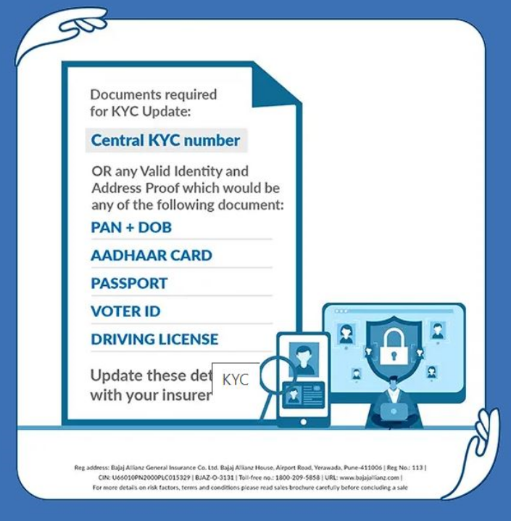
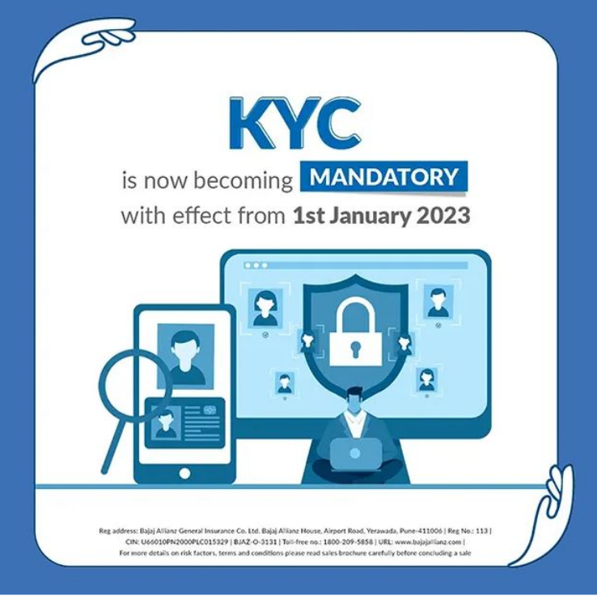
CKYC
NEW AML GUIDELINES
IMPLEMENTED BY IRDAI

Slide 9
CLAIMS COMMUNICATION
-> Claim Amount Less than 20K can be claimed through digitally.
By mentioning “Claims With Bajaj Allianz General Insurance Company Ltd.” On Claims Doc
-> Claim Amount More than 20K can’t be claimed through digitally.
Physical Documents Mandatory To Submitted
-> Claim Intimation Will Be Mandatory For All Reimbursement Claims
WEF 1-Feb-2023, Claimant can call to our call centre 1800-103-2529 for claim intimation or send mail to hat@bajajallianz.co.in Customer will be provided with Intimation number in form of “SR: XXXXXXX” and same needs to be mentioned on claim form while submitting the claim documents to us

Slide 10
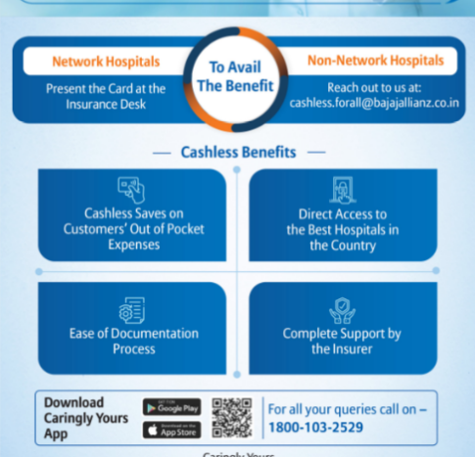
100% CASHLESS
Now BAGIC customer can avail cashless facility at Non-network hospitals
Client Mobile Number
Patient Name
Policy Details/ Health ID Card Details
Hospital Name & address
Hospital Contact Details / email id
Date of Hospitalisation
Diagnosis
email cashless.forall@bajajallianz.co.in

Slide 11
REACHABILITY – CLAIMS
For Reimbursement Claims Queries/Discrepancies
Mail To Health Admin
hat@bajajallianz.co.in
For Cashless Claims Queries/Discrepancies
Mail To Pre Authorization Team
preauth@bajajallianz.co.in

Slide 12

Initiatives
Fast Track Payments
Quick Payment option Claim paid within 48Hrs Additional discount increased by 5.07%
Instant Payment (BAGIC is First in Industry) Claim paid within 3 minutes Additional discount increased by 2%
Tariff standardization for packages 300 hospitals package rates standardized & incorporated in claim module
Mobile based QRS Paperless Hospitals’ infrastructure audit (ensuring quality providers)
System Development
Thank You

